Slide 1



SQL-Azure-Report
View in Power BI
Last data refresh:
5/19/2025 4:41:44 PM UTC
Downloaded at:
5/19/2025 4:43:47 PM UTC

Slide 2
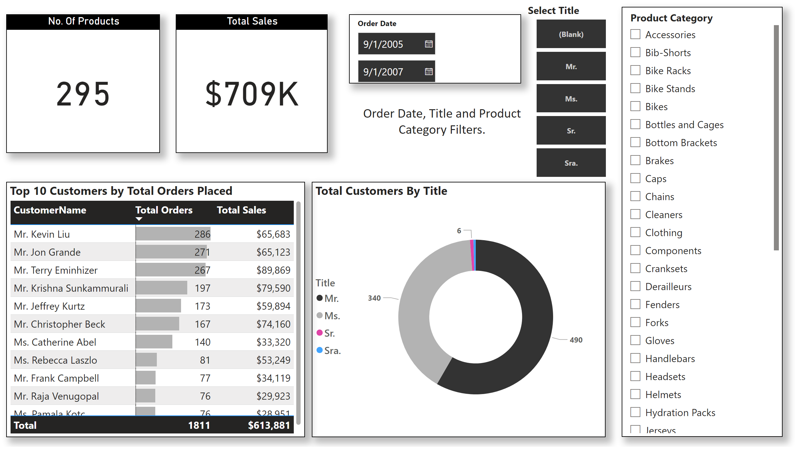
Page 1
Notes:
No. Of Products
No alt text provided
Total Sales
No alt text provided
slicer
No alt text provided
Total Customers By Title
No alt text provided
slicer
No alt text provided
Top 10 Customers by Total Orders Placed
No alt text provided
slicer
No alt text provided
textbox
No alt text provided

